Slide 1
Machine Learning
MATH42815
Friday January 12th 2024

Slide 2
Week 1
Practical 1:
Revision of IMDS and ISDS techniques
Question Time
Lecture 1:
“Basic” concepts
Practicals 2 and 3:
Forward/back/best subset selection
Predictive performance and cross-validation
Lecture 2:
Ridge, Lasso, and Principal Component Regression

Slide 3
Lecture 2 Outline
Cost functions and convexity
Gradient Descent at the end if there’s time
Maximum log-likelihood
𝓵^{p} Norms
Shrinkage
Ridge regression
Lasso regression
Spatial conceptualisation
When and why to use ridge and lasso regression
Principal component regression
Maybe: BONUS CONTENT

Slide 4
Cost Functions and Convexity

Slide 5
What is a Cost Function?
Also called a Loss Function or an Objective Function*
In a non-mathematical sense, this is the function whose output we want to minimise to declare that we have found our solution
Least Squares Regression: minimise sum of squares of residuals, or (equivalently) MSE
In the case of LSR, we are determining which values of coefficients will minimise MSE for our particular data set
Simple linear regression: Think of MSE as a surface whose height is a function of b₀ and b₁ for a given data set

Slide 6
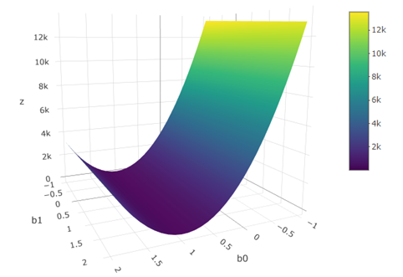


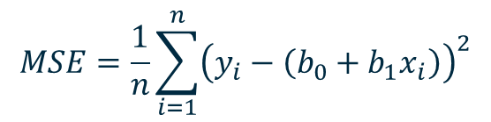
Cost Function for Simple Least Squares
$$MSE=\frac{1}{n}\sum_{i=1}^{n}{{\left(y_{i}−\left(b_{0}+b_{1}x_{i}\right)\right)}^{2}}$$

Slide 7
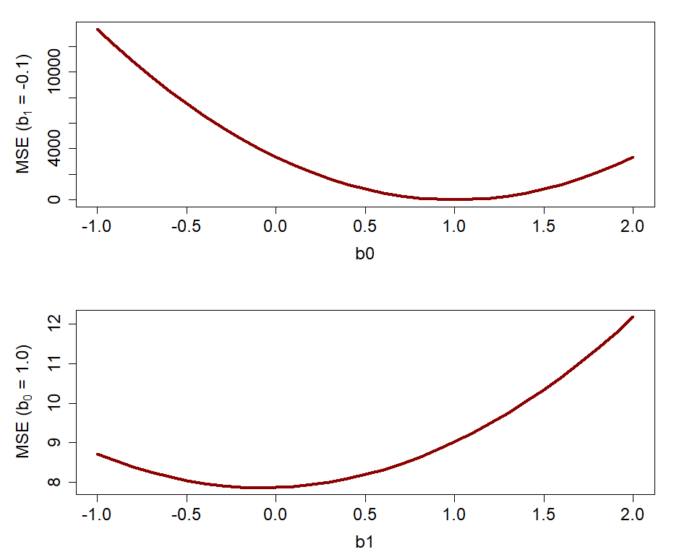
Gradient Descent
In IMDS Workshop 3 and in Wednesday’s practical, we covered using gradient descent to determine the input values which minimise a cost function
We also saw that for some functions, this method will not lead to a single global solution
How can we deal with this issue?

Slide 8
Convexity
A convex loss function has only global minima
No local minima which are not also global minima
We like these functions!
“Strictly” convex function has only one global minimum
Particularly important for iterative solving methods
Why do we use cost functions? What’s the meaning behind them?

Slide 9
Maximum Log-Likelihood

Slide 10

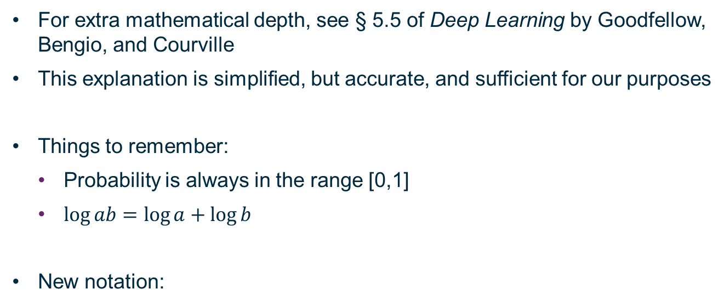
Maximum Log Likelihood
For extra mathematical depth, see § 5.5 of Deep Learning by Goodfellow, Bengio, and Courville
This explanation is simplified, but accurate, and sufficient for our purposes
Things to remember:
Probability is always in the range [0,1]
$\log{ab}=\log{a}+\log{b}$
New notation:
Mathematicians overwrite definitions of variables constantly

Slide 11
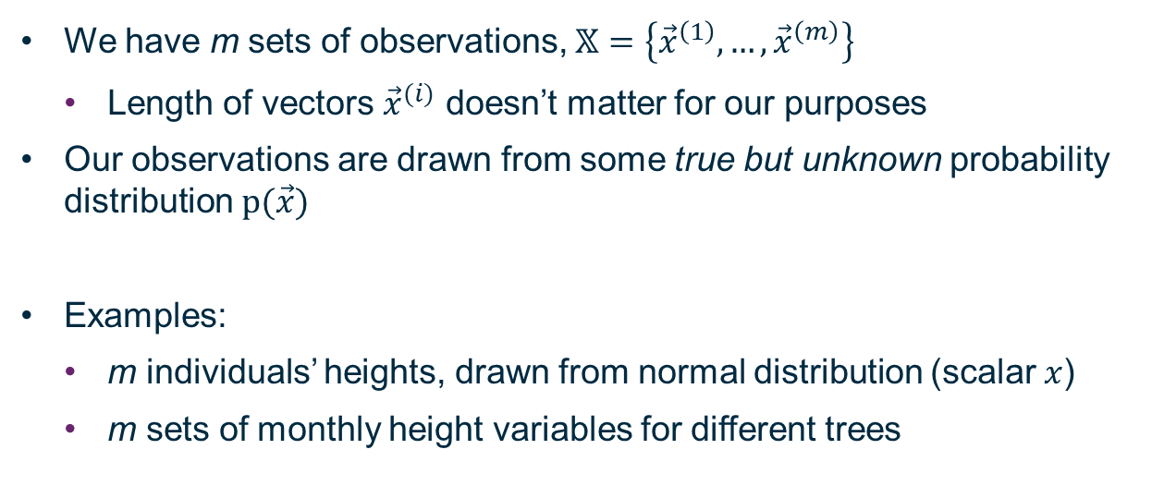
Data Sample
We have m sets of observations, $𝕏=\left\{{\vec{x}}^{\left(1\right)},…,{\vec{x}}^{\left(m\right)}\right\}$
Length of vectors ${\vec{x}}^{(i)}$ doesn’t matter for our purposes
Our observations are drawn from some true but unknown probability distribution $p(\vec{x})$
Examples:
m individuals’ heights, drawn from normal distribution (scalar $x$)
m sets of monthly height variables for different trees

Slide 12
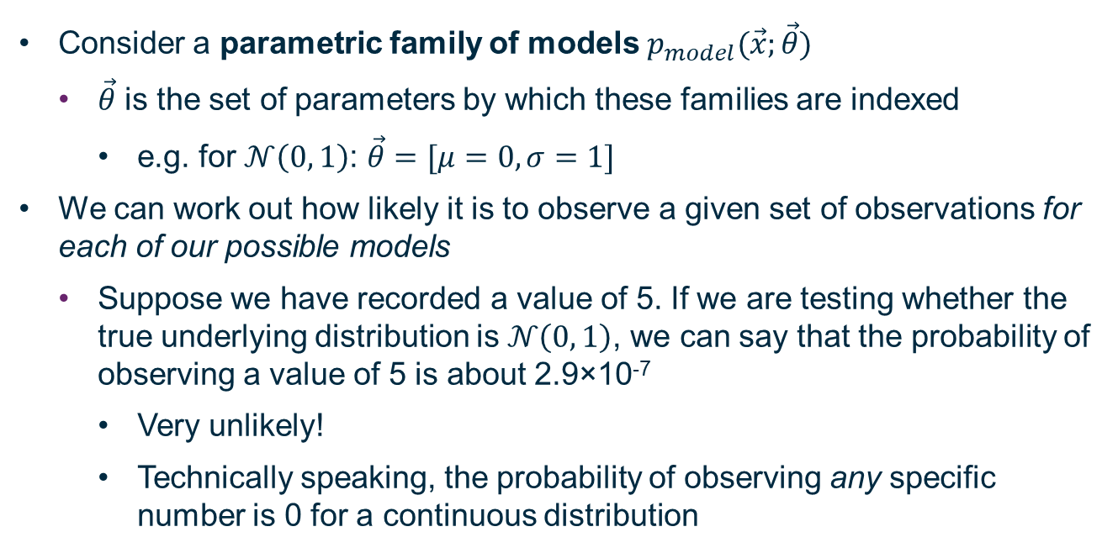
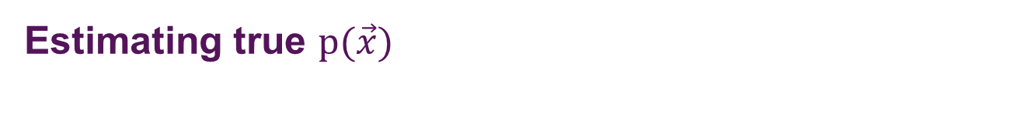
Estimating true $p(\vec{x})$
Consider a parametric family of models $p_{model}(\vec{x};\vec{θ})$
$\vec{θ}$ is the set of parameters by which these families are indexed
e.g. for $𝒩\left(0, 1\right)$: $\vec{θ}=[μ=0, σ=1]$
We can work out how likely it is to observe a given set of observations for each of our possible models
Suppose we have recorded a value of 5. If we are testing whether the true underlying distribution is $𝒩\left(0, 1\right)$, we can say that the probability of observing a value of 5 is about 2.9×10⁻⁷
Very unlikely!
Technically speaking, the probability of observing any specific number is 0 for a continuous distribution

Slide 13
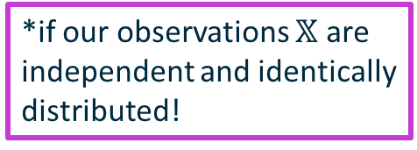
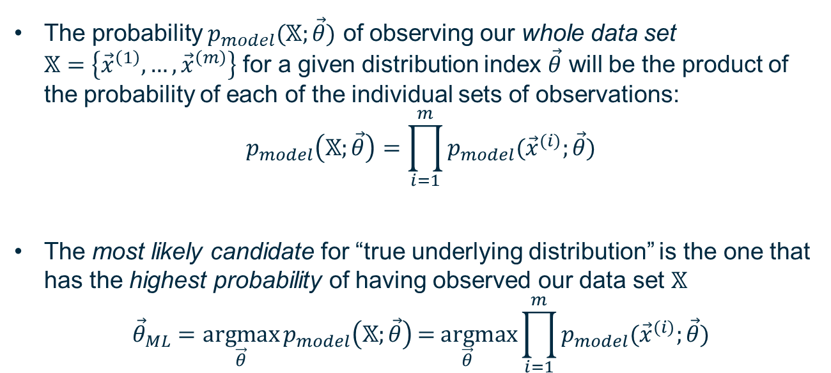
Maximum likelihood
The probability $p_{model}(𝕏;\vec{θ})$ of observing our whole data set $𝕏=\left\{{\vec{x}}^{\left(1\right)},…,{\vec{x}}^{\left(m\right)}\right\}$ for a given distribution index $\vec{θ}$ will be the product of the probability of each of the individual sets of observations:
$$p_{model}\left(𝕏;\vec{θ}\right)=\prod_{i=1}^{m}{p_{model}({\vec{x}}^{(i)};\vec{θ})}$$
The most likely candidate for “true underlying distribution” is the one that has the highest probability of having observed our data set $𝕏$
$${\vec{θ}}_{ML}=\underset{\vec{θ}}{\text{arg}max}{p_{model}\left(𝕏;\vec{θ}\right)}\underset{\vec{θ}}{\text{= }\text{arg}max}{\prod_{i=1}^{m}{p_{model}({\vec{x}}^{(i)};\vec{θ})}}$$
*if our observations $𝕏$ are independent and identically
distributed!

Slide 14
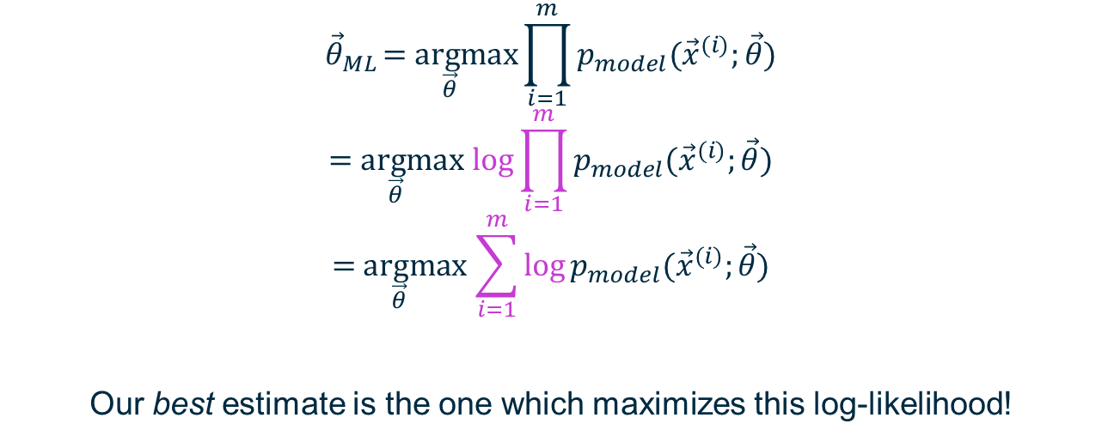
Products of probabilities get messy in practice
$${\vec{θ}}_{ML}\underset{\vec{θ}}{\text{= }\text{arg}max}{\prod_{i=1}^{m}{p_{model}({\vec{x}}^{(i)};\vec{θ})}}$$
$$\underset{\vec{θ}}{\text{= }\text{arg}max}\log{\prod_{i=1}^{m}{p_{model}({\vec{x}}^{(i)};\vec{θ})}}$$
$$\underset{\vec{θ}}{\text{= }\text{arg}max}\sum_{i=1}^{m}{\log{p_{model}({\vec{x}}^{(i)};\vec{θ})}}$$
Our best estimate is the one which maximizes this log-likelihood!

Slide 15
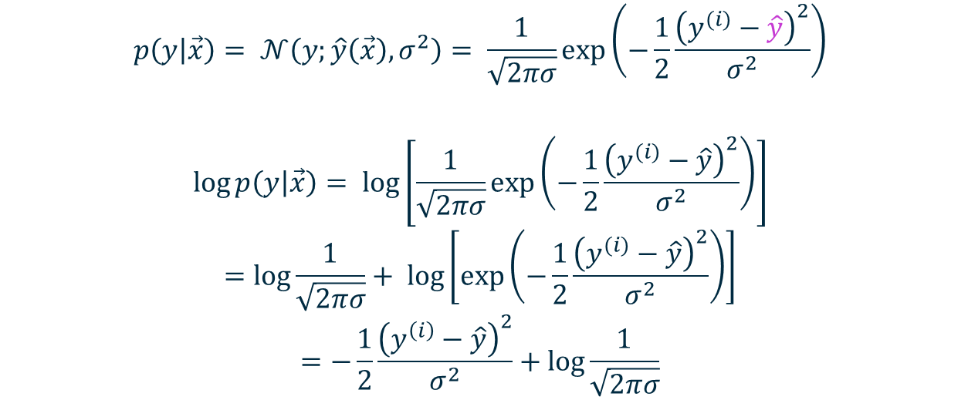
Example: Least Squares Regression
$$p\left(y | \vec{x}\right)= 𝒩\left(y;\hat{y}\left(\vec{x}\right),σ^{2}\right)= \frac{1}{\sqrt{2πσ}}\text{exp}\left(−\frac{1}{2}\frac{{\left(y^{(i)}−\hat{y}\right)}^{2}}{σ^{2}}\right)$$
$$\log{p\left(y | \vec{x}\right)}= \log\left[\frac{1}{\sqrt{2πσ}}\text{exp}\left(−\frac{1}{2}\frac{{\left(y^{(i)}−\hat{y}\right)}^{2}}{σ^{2}}\right)\right]$$
$$=\log{\frac{1}{\sqrt{2πσ}}+ \log\left[\text{exp}\left(−\frac{1}{2}\frac{{\left(y^{(i)}−\hat{y}\right)}^{2}}{σ^{2}}\right)\right]}$$
$$=−\frac{1}{2}\frac{{\left(y^{\left(i\right)}−\hat{y}\right)}^{2}}{σ^{2}}+\log{\frac{1}{\sqrt{2πσ}}}$$

Slide 16
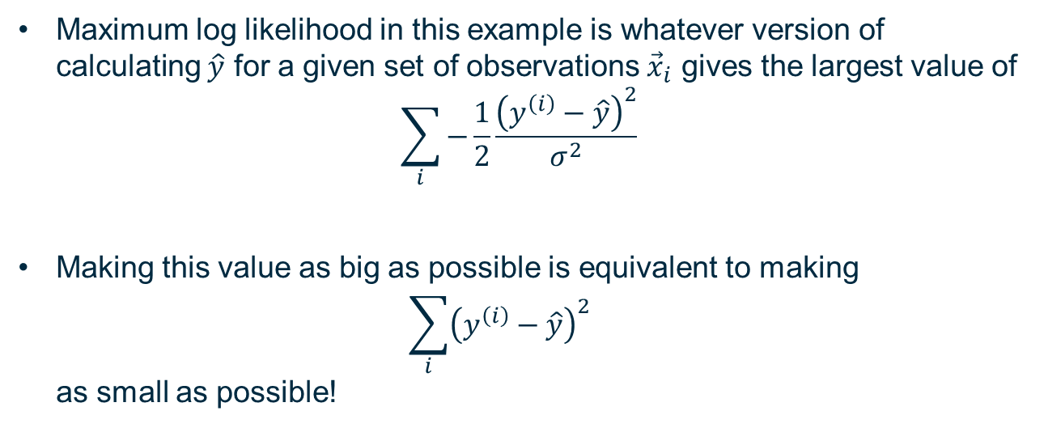
Relating MLL and Cost Functions
Maximum log likelihood in this example is whatever version of calculating $\hat{y}$ for a given set of observations ${\vec{x}}_{i}$ gives the largest value of
$$\sum_{i}{−\frac{1}{2}\frac{{\left(y^{\left(i\right)}−\hat{y}\right)}^{2}}{σ^{2}}}$$
Making this value as big as possible is equivalent to making $\sum_{i}{{\left(y^{\left(i\right)}−\hat{y}\right)}^{2}}$ as small as possible!

Slide 17

$𝓵$^{p} Norms

Slide 18
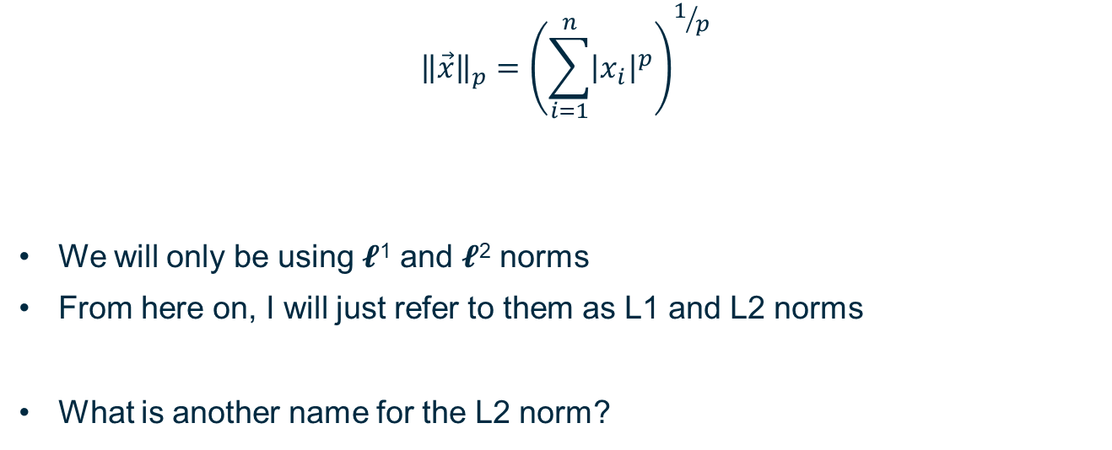
What are 𝓵^{p} Norms?
$${\left\|\vec{x}\right\|}_{p}={\left(\sum_{i=1}^{n}{{\left|x_{i}\right|}^{p}}\right)}^{1/p}$$
We will only be using 𝓵¹ and 𝓵² norms
From here on, I will just refer to them as L1 and L2 norms
What is another name for the L2 norm?

Slide 19
Shrinkage

Slide 20
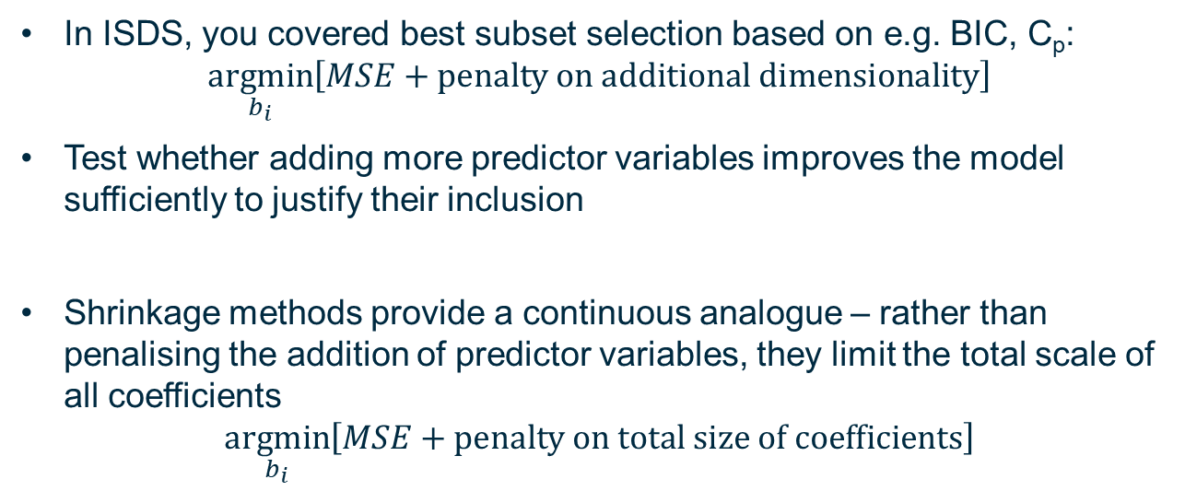
Continuous penalty on additional predictors
In ISDS, you covered best subset selection based on e.g. BIC, C_{p}: $\underset{b_{i}}{argmin}\left[MSE+\text{penalty} \text{on} \text{additional} \text{dimensionality}\right]$
Test whether adding more predictor variables improves the model sufficiently to justify their inclusion
Shrinkage methods provide a continuous analogue – rather than penalising the addition of predictor variables, they limit the total scale of all coefficients
$$\underset{b_{i}}{argmin}\left[MSE+\text{penalty} \text{on} \text{total} \text{size} \text{of} \text{coefficients}\right]$$

Slide 21
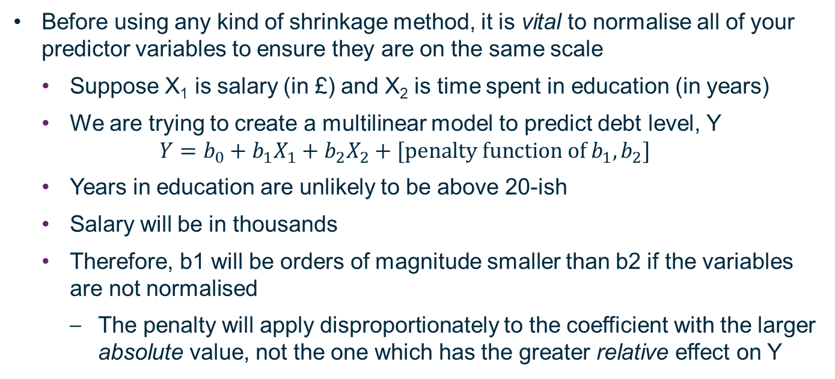
Normalisation of Predictor Variables
Before using any kind of shrinkage method, it is vital to normalise all of your predictor variables to ensure they are on the same scale
Suppose X₁ is salary (in £) and X₂ is time spent in education (in years)
We are trying to create a multilinear model to predict debt level, Y
$$Y=b_{0}+b_{1}X_{1}+b_{2}X_{2}+[\text{penalty} \text{function} \text{of} b_{1},b_{2}]$$
Years in education are unlikely to be above 20-ish
Salary will be in thousands
Therefore, b1 will be orders of magnitude smaller than b2 if the variables are not normalised
The penalty will apply disproportionately to the coefficient with the larger absolute value, not the one which has the greater relative effect on Y

Slide 22
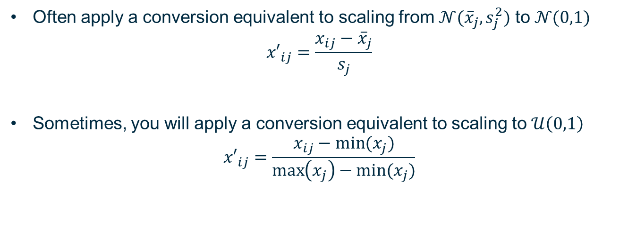
How to normalise?
Often apply a conversion equivalent to scaling from $𝒩({\overline{x}}_{j},s_{j}^{2})$ to $𝒩(0,1)$
$${x′}_{ij}=\frac{x_{ij}−{\overline{x}}_{j}}{s_{j}}$$
Sometimes, you will apply a conversion equivalent to scaling to $𝒰\left(0,1\right)$
$${x′}_{ij}=\frac{x_{ij}−min⁡(x_{j})}{\max\left(x_{j}\right)−min⁡(x_{j})}$$

Slide 23
Ridge Regression

Slide 24
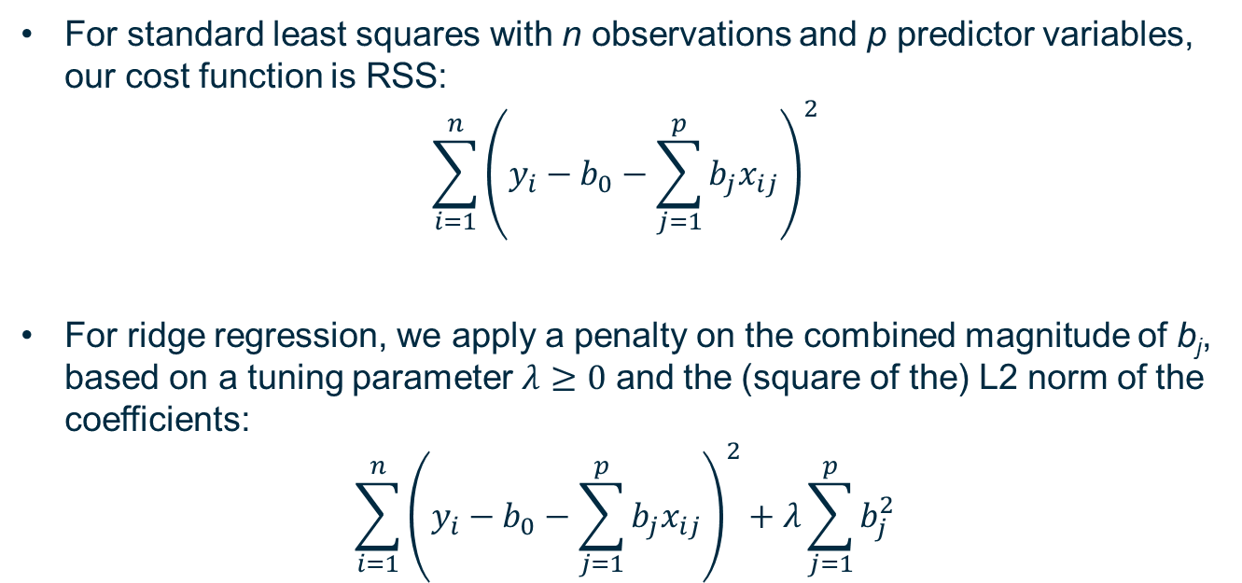
Cost Function for Ridge Regression
For standard least squares with n observations and p predictor variables, our cost function is RSS:
$$\sum_{i=1}^{n}{{\left(y_{i}−b_{0}−\sum_{j=1}^{p}{b_{j}x_{ij}}\right)}^{2}}$$
For ridge regression, we apply a penalty on the combined magnitude of b_{j}, based on a tuning parameter $λ≥0$ and the (square of the) L2 norm of the coefficients:
$$\sum_{i=1}^{n}{{\left(y_{i}−b_{0}−\sum_{j=1}^{p}{b_{j}x_{ij}}\right)}^{2}}+λ\sum_{j=1}^{p}{b_{j}^{2}}$$

Slide 25
Lasso Regression

Slide 26
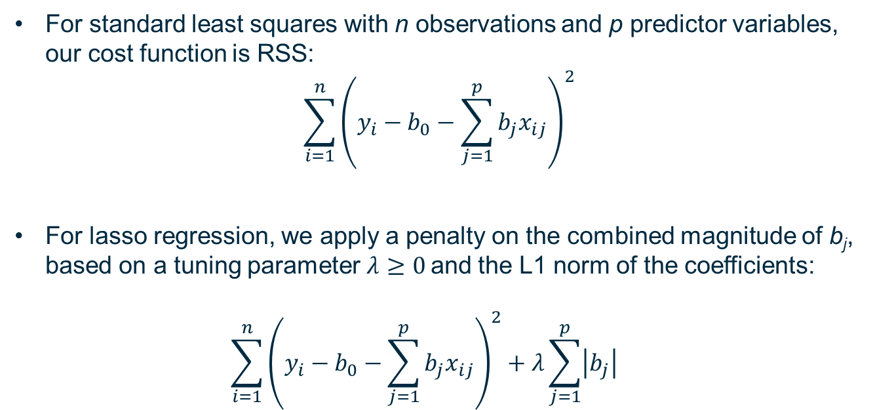
Cost Function for Lasso Regression
For standard least squares with n observations and p predictor variables, our cost function is RSS:
$$\sum_{i=1}^{n}{{\left(y_{i}−b_{0}−\sum_{j=1}^{p}{b_{j}x_{ij}}\right)}^{2}}$$
For lasso regression, we apply a penalty on the combined magnitude of b_{j}, based on a tuning parameter $λ≥0$and the L1 norm of the coefficients: $\sum_{i=1}^{n}{{\left(y_{i}−b_{0}−\sum_{j=1}^{p}{b_{j}x_{ij}}\right)}^{2}}+λ\sum_{j=1}^{p}{\left|b_{j}\right|}$

Slide 27
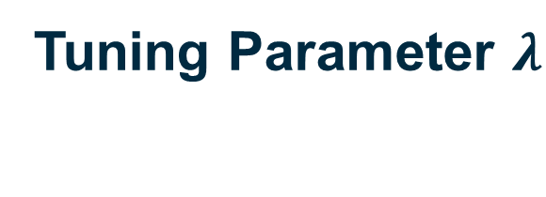
Tuning Parameter $λ$

Slide 28
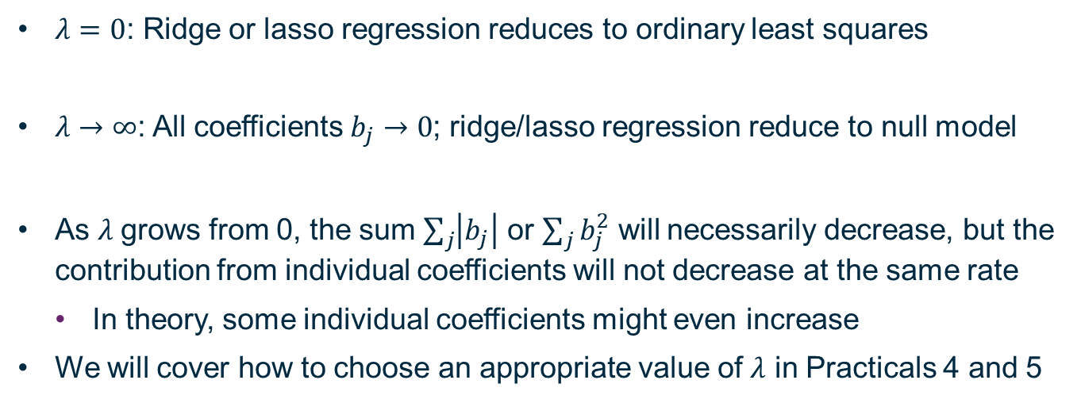

Tuning Parameter $λ$
$λ=0$: Ridge or lasso regression reduces to ordinary least squares
$λ→∞$: All coefficients $b_{j}→0$; ridge/lasso regression reduce to null model
As $λ$grows from 0, the sum $\sum_{j}{\left|b_{j}\right|}$ or $\sum_{j}{b_{j}^{2}}$ will necessarily decrease, but the contribution from individual coefficients will not decrease at the same rate
In theory, some individual coefficients might even increase
We will cover how to choose an appropriate value of $λ$ in Practicals 4 and 5

Slide 29
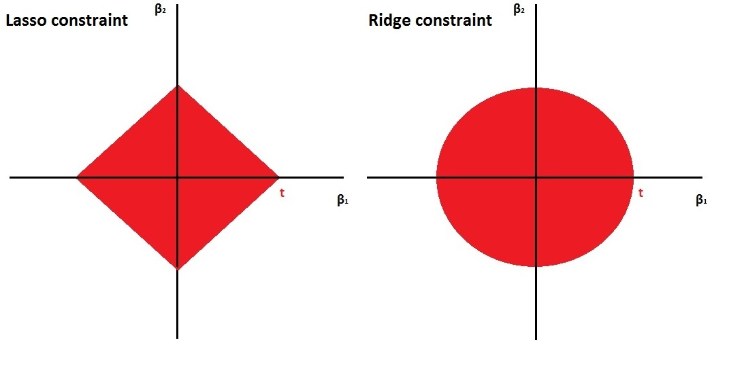

Constrained optimisation
We can think of these methods as defining a limited region of acceptable values of b_{j} based on a maximum value of the relevant L-p norm
The maximum acceptable value t will be inversely proportional to $λ$
In the 2-D case, we can easily visualise this region of acceptable values
Sam Jackson

Slide 30
When and Why to Use Ridge and Lasso Regression

Slide 31
Bias-Variance Trade-Off

Slide 32
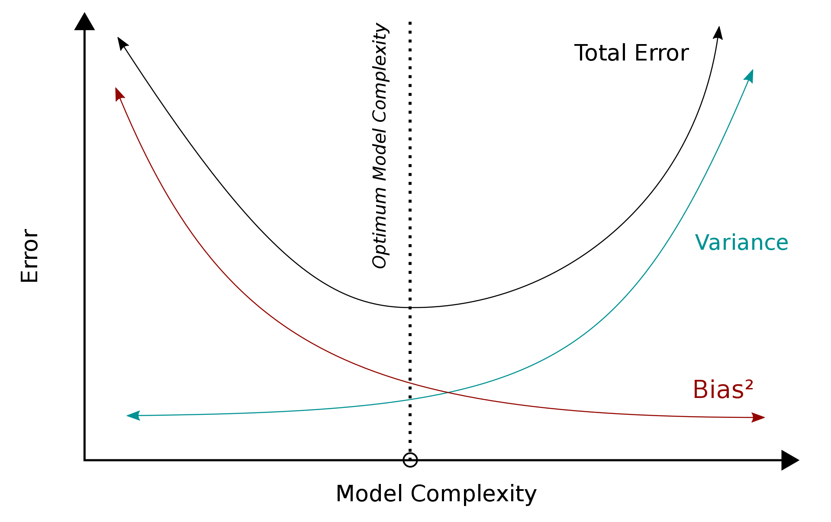
Bias-Variance Tradeoff
By Bigbossfarin - Own work, CC0, https://commons.wikimedia.org/w/index.php?curid=105307219

Slide 33
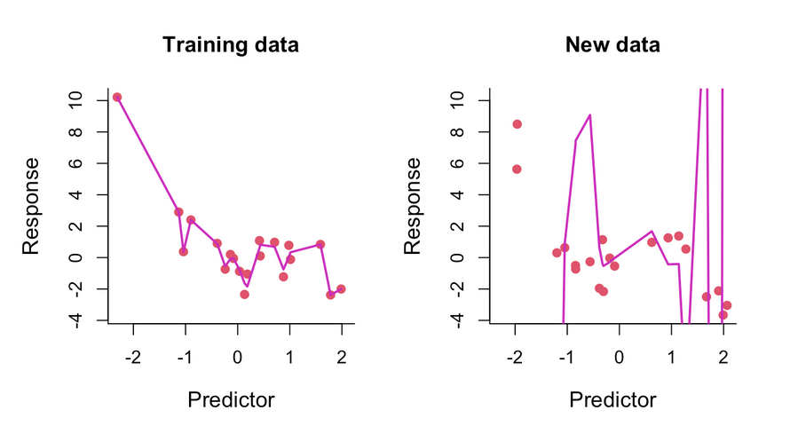
Overfitting
Sam Jackson

Slide 34
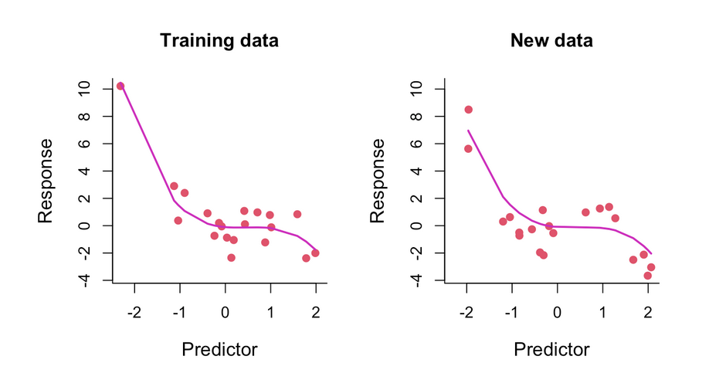
Appropriate level of fitting
Sam Jackson

Slide 35
Overcoming Multicollinearity

Slide 36

Multicollinearity
$$Y=X_{1}−X_{2}+ε$$
True model: ${β_{0}=0, β}_{1}=1,β_{2}=−1$
$$X_{1} \sim 𝒩\left(0,1\right)$$
$$X_{2} \sim 𝒩\left({0.9X}_{1},{0.2}^{2}\right)$$
$$\sim 0.9X_{1}− 𝒩(0,{0.2}^{2})$$
$$Y=0.1 X_{1}+ 𝒩\left(0,{0.2}^{2}\right)+ε$$

Slide 37
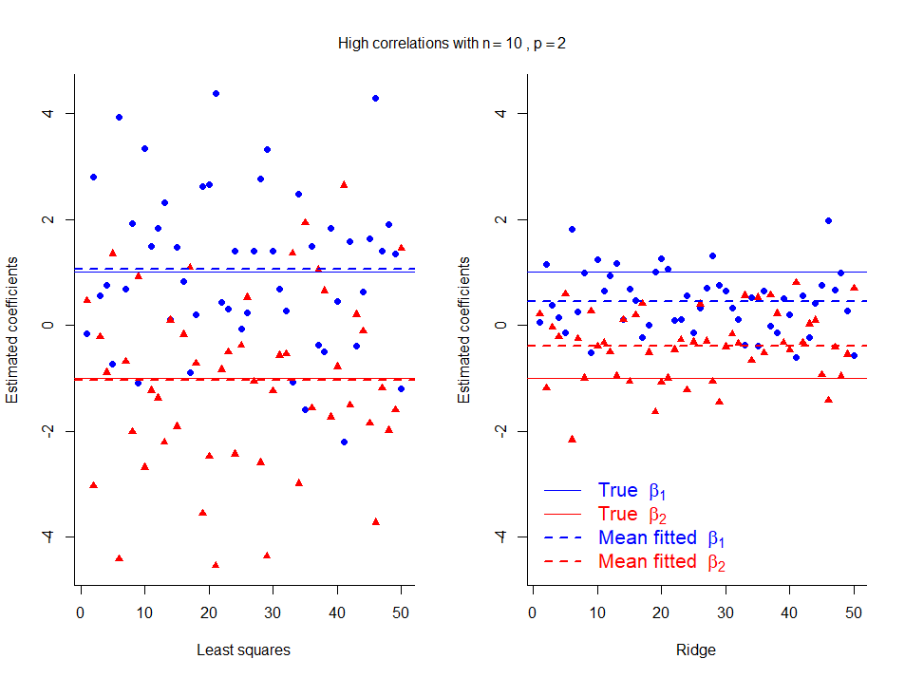
Ridge Regression Introduces Bias, Reduces Variance
Small data set (n=10)
Strong multicollinearity
Can improve test error
→ better prediction at a cost of interpretability!

Slide 38
Singular Least Squares

Slide 39
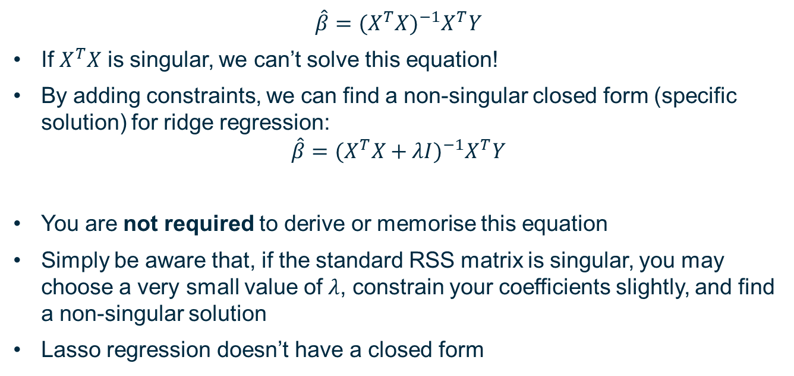
Ridge Regression Resolves Singularity
$$\hat{β}={{(X^{T}X)}^{−1}X}^{T}Y$$
If $X^{T}X$ is singular, we can’t solve this equation!
By adding constraints, we can find a non-singular closed form (specific solution) for ridge regression:
$$\hat{β}={{(X^{T}X+λI)}^{−1}X}^{T}Y$$
You are not required to derive or memorise this equation
Simply be aware that, if the standard RSS matrix is singular, you may choose a very small value of $λ$, constrain your coefficients slightly, and find a non-singular solution
Lasso regression doesn’t have a closed form

Slide 40
Automated Subset Selection

Slide 41
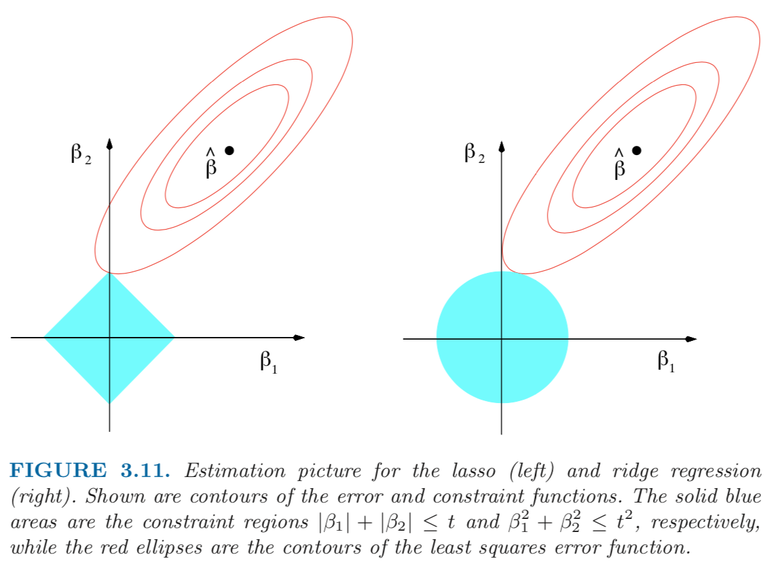
Spatial representation of solutions
Figure 3.11 from The Elements of Statistical Learning by Hastie, Tibshirani, and Friedman

Slide 42

Interpretation of Figure 3.11
The contours represent constant values of RSS
Surface of RSS calculated based on the data set being fitted and local values of b_{j} (or $β_{j}$ in this Figure)

Slide 43
Cost Function for Simple Least Squares
$$MSE=\frac{1}{n}\sum_{i=1}^{n}{{\left(y_{i}−\left(b_{0}+b_{1}x_{i}\right)\right)}^{2}}$$

Slide 44
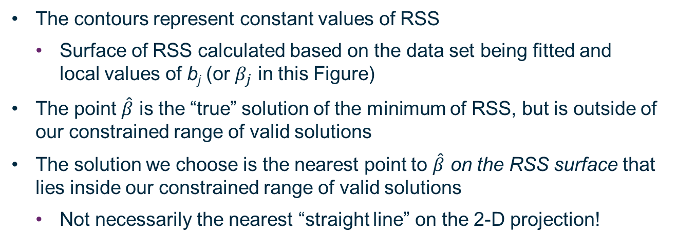
Interpretation of Figure 3.11
The contours represent constant values of RSS
Surface of RSS calculated based on the data set being fitted and local values of b_{j} (or $β_{j}$ in this Figure)
The point $\hat{β}$ is the “true” solution of the minimum of RSS, but is outside of our constrained range of valid solutions
The solution we choose is the nearest point to $\hat{β}$ on the RSS surface that lies inside our constrained range of valid solutions
Not necessarily the nearest “straight line” on the 2-D projection!

Slide 45
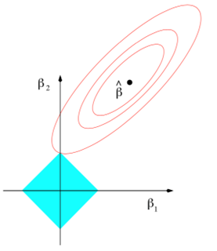
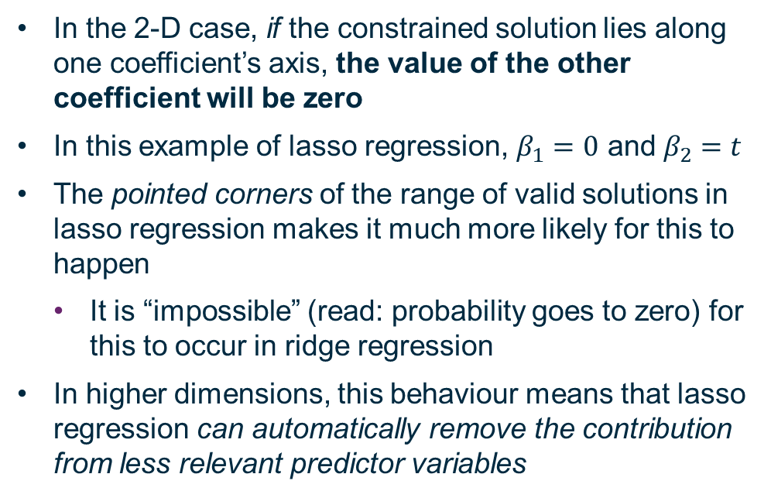
Lasso Automates Subset Selection
In the 2-D case, if the constrained solution lies along one coefficient’s axis, the value of the other coefficient will be zero
In this example of lasso regression, $β_{1}=0$ and $β_{2}=t$
The pointed corners of the range of valid solutions in lasso regression makes it much more likely for this to happen
It is “impossible” (read: probability goes to zero) for this to occur in ridge regression
In higher dimensions, this behaviour means that lasso regression can automatically remove the contribution from less relevant predictor variables

Slide 46
Convexity
Since we’re discussing parameter space topology: both ridge and lasso regression are both convex optimisation problems
No local minimum which is not also a global minimum

Slide 47
Limited Data Set

Slide 48
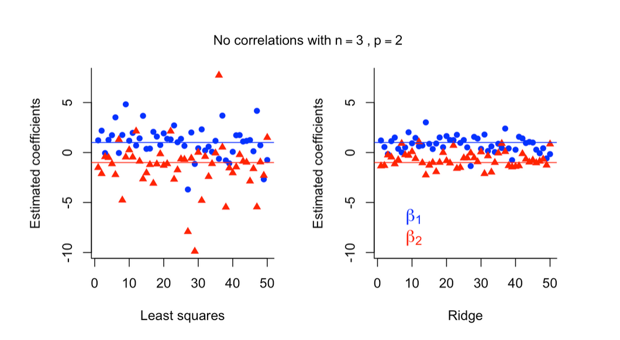

Very few data points relative to feature variables
Choice of $λ$ is key!
Many possible combinations of $β_{1}$, $β_{2}$; but since the true values are within the valid range defined by $λ$, and the formula for ridge regression links coefficient values independently of their associated predictor variables, it becomes less likely for another set of coefficients to represent a minimum of RSS and satisfy these constraints.

Slide 49
Spatial representation of solutions
Figure 3.11 from The Elements of Statistical Learning by Hastie, Tibshirani, and Friedman

Slide 50
Principal Component Regression

Slide 51
Hand-Waving Guide to Multilinear Regression
Imagine a giant cube of jelly
“Jello”
The cube has chunks of fruit floating inside it in a pattern – not randomly
Suppose the height Z of the fruit is a linear combination of their X and Y coordinates
Multilinear regression: find the equation of the plane that “slices through” the fruit in the “best” way

Slide 52
Hand-Waving Guide to Principal Component Regression (PCR)
Instead of slicing straight through the jelly, imagine a top-down view
Find the direction that most of the variability in your data happens in
This is the first principal component
Because this is two-dimensional, the second principal component is just at 90° to the first
In higher dimensions, you will need to keep finding the dimension that explains the biggest part of the remaining variability

Slide 53
Why Do We Use PCR?
Hypothesis: Since we want a model that explain changes in Y based on changes in X_{i}, if we find the directions where most of the changes in X_{i} are happening, we can explain changes in Y more efficiently with fewer variables
Assumption: The relationship between Y and X_{i} is driven by changes in the direction with the greatest variability in X_{i}
If PCR works for a given system, you can often model your output variable very well, with fewer input variables
However, the tradeoff is that PCR is much harder to interpret
Remember the two main reasons we use models!

Slide 54
Summary (and Bonus Content if there’s time)

Slide 55
Summary
Cost Functions
Maximum Log-Likelihood
Oh no, maths!
Why minimise RSS/MSE?
Shrinkage
Ridge regression
Lasso regression
PCR
Do we have time for bonus content?

Slide 56
Gradient Descent

Slide 57
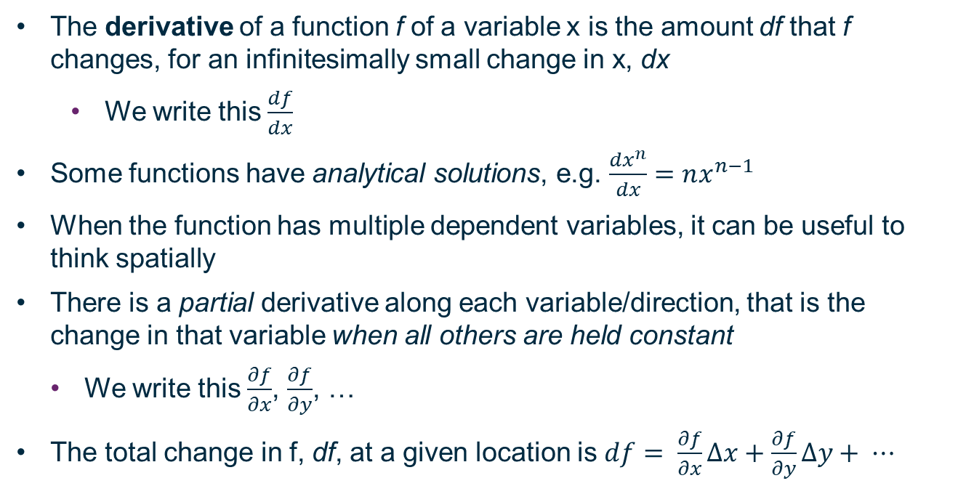
Derivatives
The derivative of a function f of a variable x is the amount df that f changes, for an infinitesimally small change in x, dx
We write this $\frac{df}{dx}$
Some functions have analytical solutions, e.g. $\frac{{dx}^{n}}{dx}=nx^{n−1}$
When the function has multiple dependent variables, it can be useful to think spatially
There is a partial derivative along each variable/direction, that is the change in that variable when all others are held constant
We write this $\frac{∂f}{∂x}$, $\frac{∂f}{∂y}$, …
The total change in f, df, at a given location is $df= \frac{∂f}{∂x}∆x+\frac{∂f}{∂y}∆y+ ⋯$

Slide 58
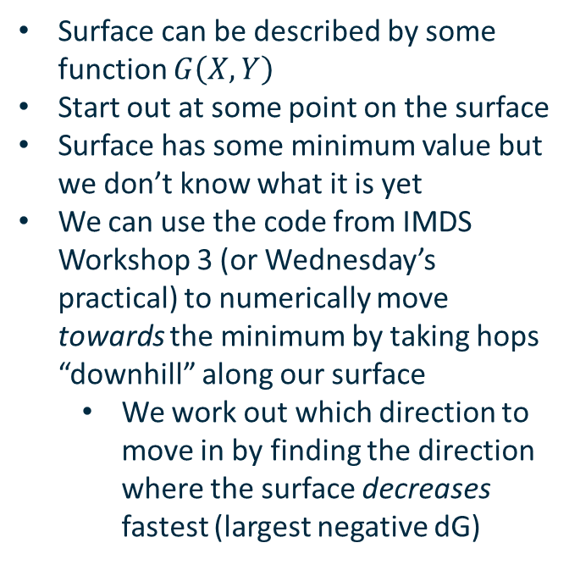
Cost Function for Simple Least Squares
Surface can be described by some function $G\left(X,Y\right)$
Start out at some point on the surface
Surface has some minimum value but we don’t know what it is yet
We can use the code from IMDS Workshop 3 (or Wednesday’s practical) to numerically move towards the minimum by taking hops “downhill” along our surface
We work out which direction to move in by finding the direction where the surface decreases fastest (largest negative dG)

Slide 59
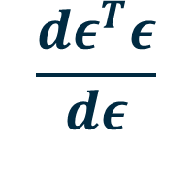
$$\frac{dε^{T}ε}{dε}$$

Slide 60
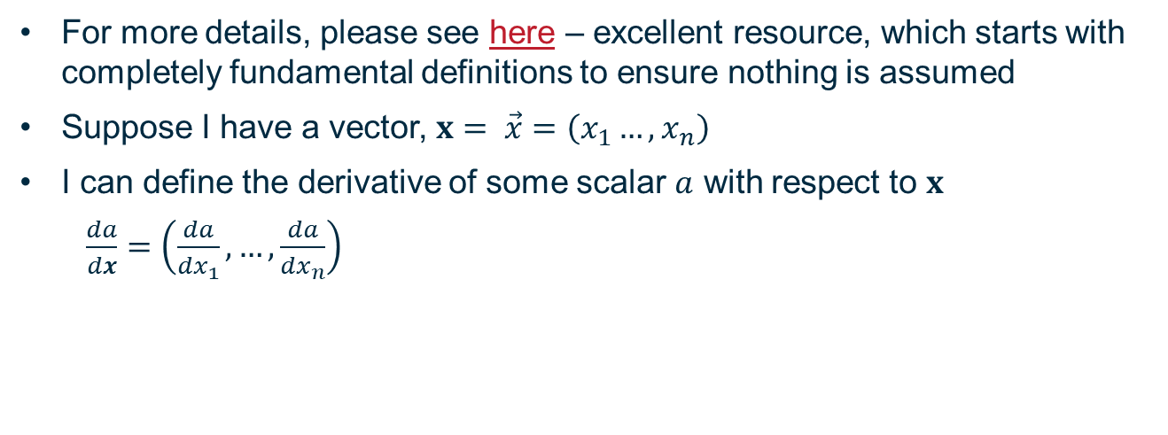
Derivatives of Vectors
For more details, please see here – excellent resource, which starts with completely fundamental definitions to ensure nothing is assumed
Suppose I have a vector, $x= \vec{x}=\left(x_{1}…,x_{n}\right)$
I can define the derivative of some scalar $a$ with respect to $x$
$\frac{da}{dx}=\left(\frac{da}{{dx}_{1}},…,\frac{da}{{dx}_{n}}\right)$

Slide 61
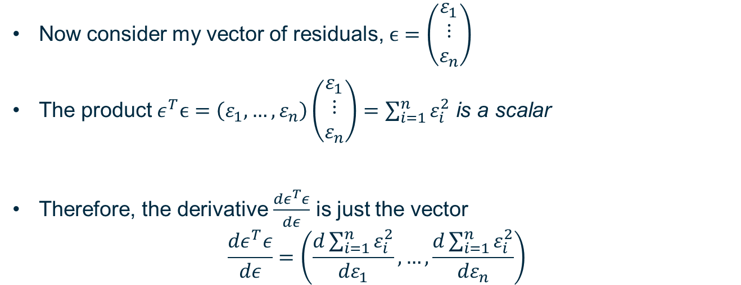
Differentiating the residual vector
Now consider my vector of residuals, $ϵ=\left(\begin{matrix}ε_{1} \\ ⋮ \\ ε_{n}\end{matrix}\right)$
The product $ε^{T}ϵ=\left(ε_{1},…,ε_{n}\right)\left(\begin{matrix}ε_{1} \\ ⋮ \\ ε_{n}\end{matrix}\right)=\sum_{i=1}^{n}{ε_{i}^{2}}$ is a scalar
Therefore, the derivative $\frac{dε^{T}ε}{dε}$ is just the vector
$$\frac{dε^{T}ε}{dε}=\left(\frac{d\sum_{i=1}^{n}{ε_{i}^{2}}}{{dε}_{1}},…,\frac{d\sum_{i=1}^{n}{ε_{i}^{2}}}{{dε}_{n}}\right)$$

Slide 62

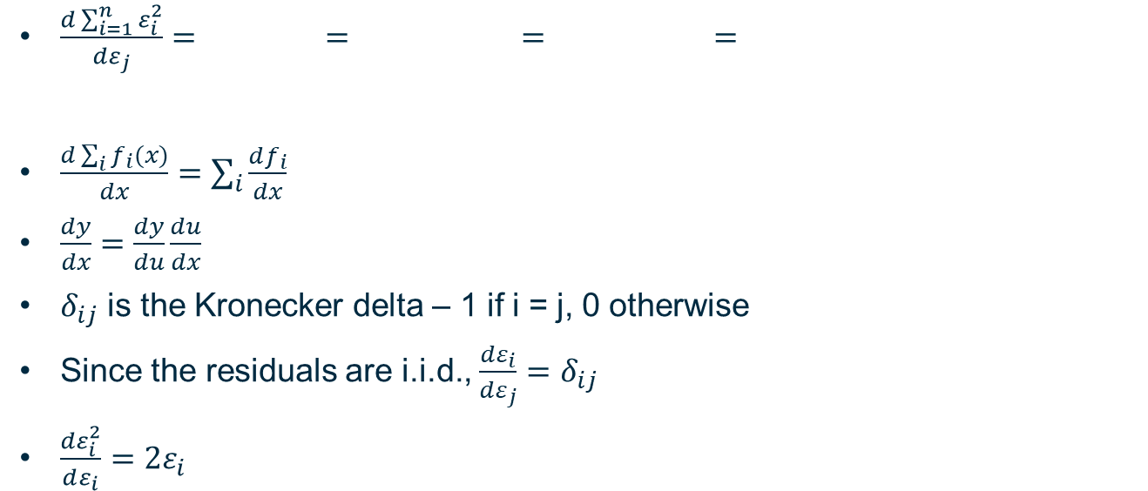



Simplify this summation
$$\sum_{i=1}^{n}{\frac{dε_{i}^{2}}{dε_{j}}}$$
$$\sum_{i=1}^{n}{\frac{dε_{i}^{2}}{dε_{i}}}\frac{{dε}_{i}}{{dε}_{j}}$$
$$\sum_{i=1}^{n}{2ε_{i}δ_{ij}}$$
$\frac{d\sum_{i=1}^{n}{ε_{i}^{2}}}{{dε}_{j}}=\sum_{i=1}^{n}{\frac{dε_{i}^{2}}{dε_{j}}}=\sum_{i=1}^{n}{\frac{dε_{i}^{2}}{dε_{i}}}\frac{{dε}_{i}}{{dε}_{j}}=$ $\sum_{i=1}^{n}{2ε_{i}δ_{ij}}=2ε_{i}$
$\frac{d\sum_{i}{f_{i}(x)}}{dx}=\sum_{i}{\frac{df_{i}}{dx}}$
$\frac{dy}{dx}=\frac{dy}{du}\frac{du}{dx}$
$δ_{ij}$ is the Kronecker delta – 1 if i = j, 0 otherwise
Since the residuals are i.i.d., $\frac{{dε}_{i}}{{dε}_{j}}=$ $δ_{ij}$
$\frac{dε_{i}^{2}}{dε_{i}}=2ε_{i}$
$$2ε_{i}$$

Slide 63

Solved!
The term $\frac{d\sum_{i=1}^{n}{ε_{i}^{2}}}{{dε}_{j}}$ is just $2ε_{i}$!
$\frac{dε^{T}ε}{dε}=\left(\frac{d\sum_{i=1}^{n}{ε_{i}^{2}}}{{dε}_{1}},…,\frac{d\sum_{i=1}^{n}{ε_{i}^{2}}}{{dε}_{n}}\right)=\left(2ε_{1},…,2ε_{n}\right)=2ε^{T}$

